Slide 1


Design Considerations when creating a printable standard-based report card
DO THIS FIRST
ASK FOR AN EXAMPLE
Bob Cornacchioli
get2bobc@gmail.com
http://www.derotechnical.com

Slide 2

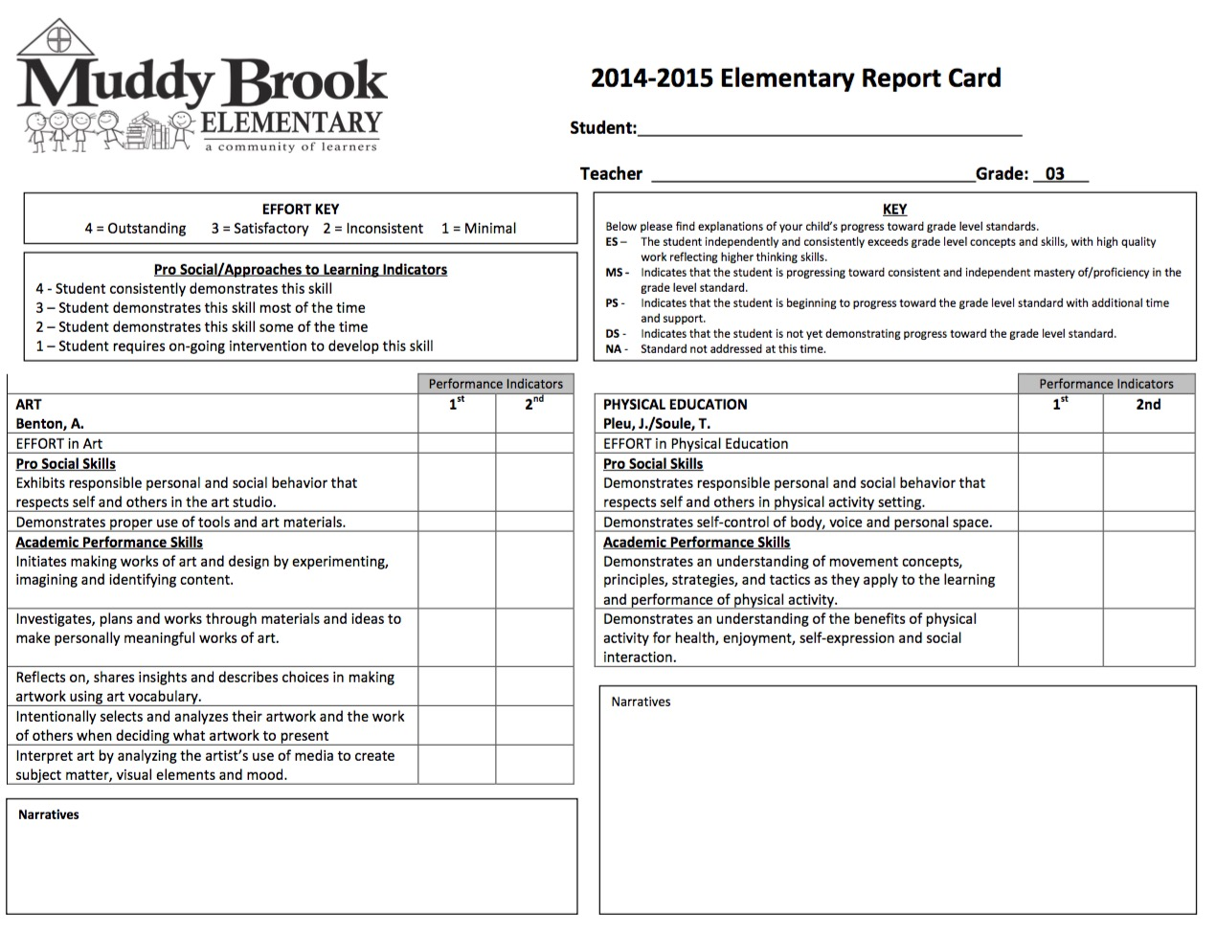
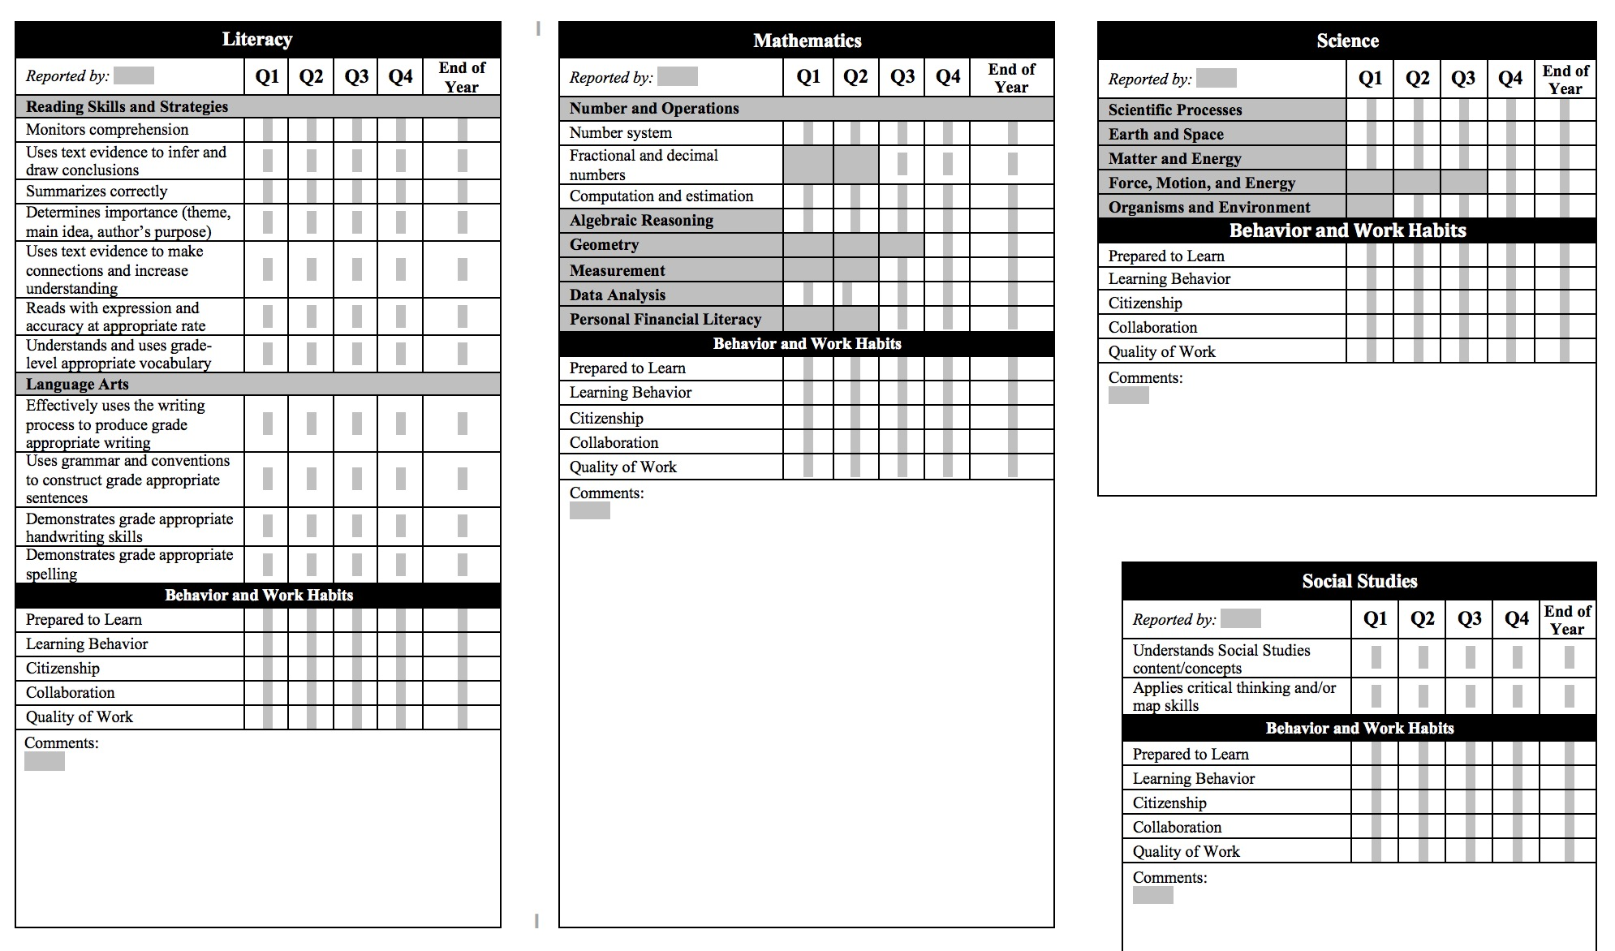
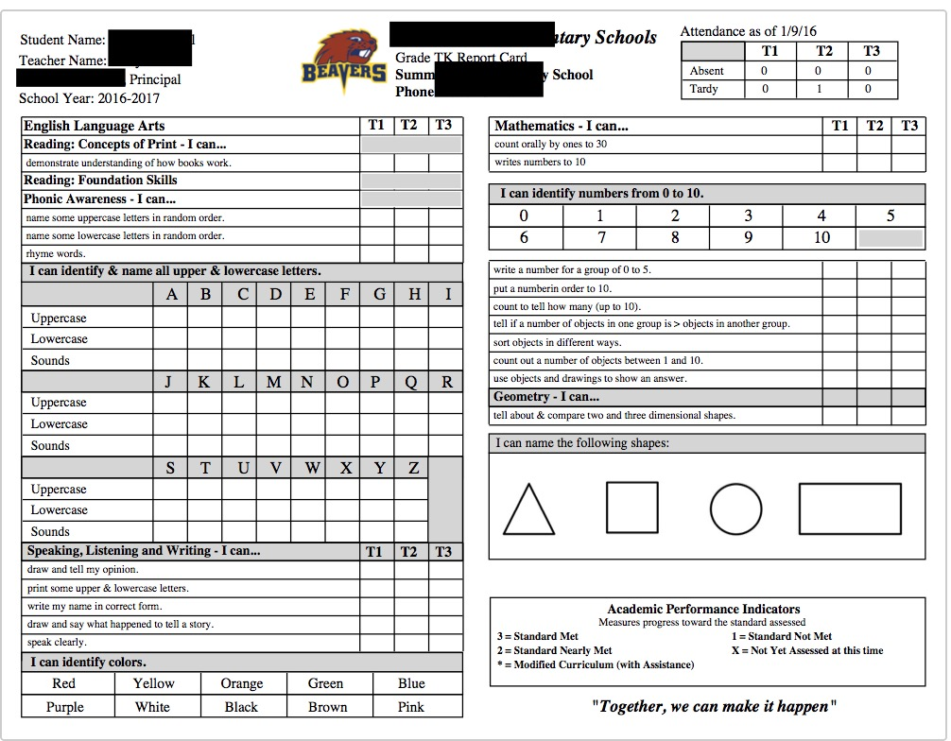
MUST HAVE’s – WORK AROUNDS
DO YOU HAVE AN EXAMPLE?

Slide 3

Agenda/Participants will be engaged in:
Brainstorming session
Tips and tricks of creating a printable standard based report card
Learning report card language
Object Reports vs Dynamic Options Online/Printable
NOT DYNAMIC so it’s all about real estate
How the SBRC relates to the PTP
Special Education Students/Scales
Exploring the curriculum side of standards
Parkbench VisualPST (object report writer)
(free-trial licenses available)
Target Audience – Admins/Curriculum/Lead Secretaries
All PPT can be found @
www.derotechnical.com

Slide 4




CEO - DERO Technical Services (2007)
Marketing/- ParkBench Software Trainer (2007)
Evangelist/Process Lead- Level Data (2010)
PSISJS Partner – Standards/Trainer (2013)
Alpha/Beta Team for PS and PTP
Bob Cornacchioli
Director of Technology and Media Services
Shrewsbury Public Schools (16 yrs.)
PowerSchool Administrator (6 yrs.)

Slide 5

What’s your role in the district?
Trained in Object Reports?
Created Standard Based Report Cards?
Hybrid Report with Traditional & Standard grades?

Slide 6
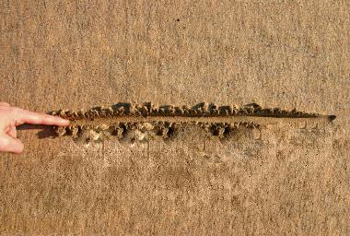
CURRICULUM/ADMIN
DRAW A LINE IN THE SAND
TECHNICAL
How flexible is your curriculum leadership
to accepting possible work-arounds?

Slide 7

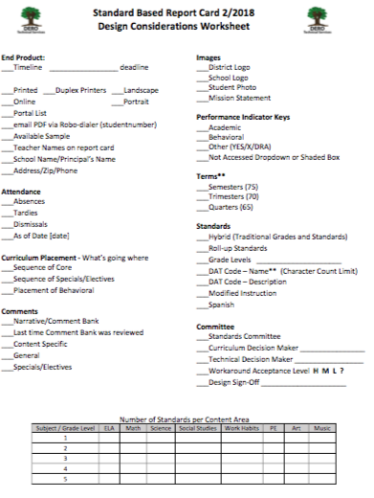

http://www.derotechnical.com/REPORTCARDS/REPORTCARDS.html
This is a chart that you fill in to see if the # of standards per content area per grade level – Look for any red flags!

Slide 8
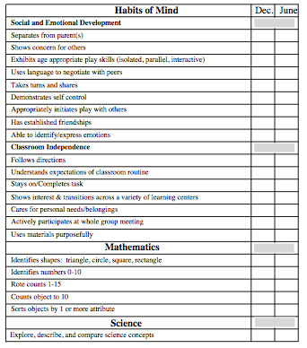
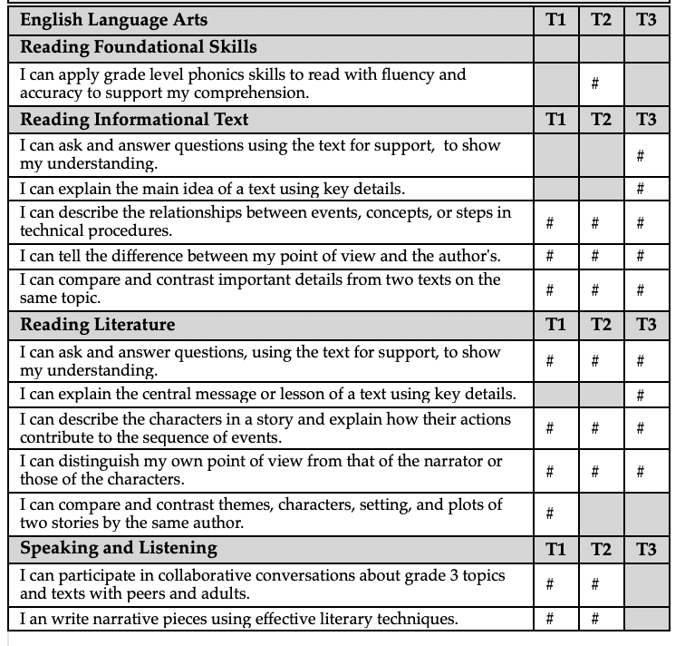
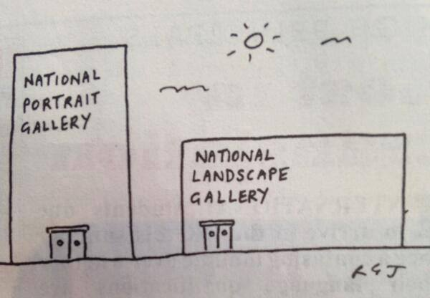
Design Considerations
Years & Terms
    Semester – Trimester – Quarters
Headers vs. Standards
Graded or not
Landscape vs. Portrait
  More space for standard text (65)
  Larger Font- Landscape
Shading
Lines
  Gray Boxes
Code vs. Text (Code & Text)
  ^(*std.info.name;02.LA.01)
  You or someone else

Slide 9



Design Considerations
Standards – How many and Where
Ask to see the standards, even if they are not in Excel!
How many standards per content area?
Create a chart to show standards per content per grade level
How long are the standard names (65/70/75) or descriptions? This could impact your design options.
How many comments, which subjects by grade level get comments?
Which standards are graded, which aren’t?
Hybrid’s anyone?
Where do they want a particular subject to be located on the printed report card

Slide 10
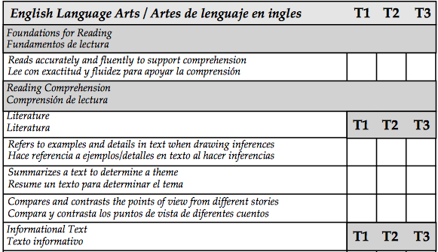
Report Card & Standards Relationship
CELA.4.2
CELA.4.3
CELA.4.4
CELA.4.5
CELA.4.6
CELA.4.7
CELA.4.8
CELA.4.9

Slide 11
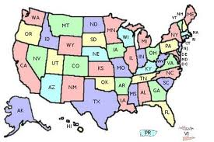
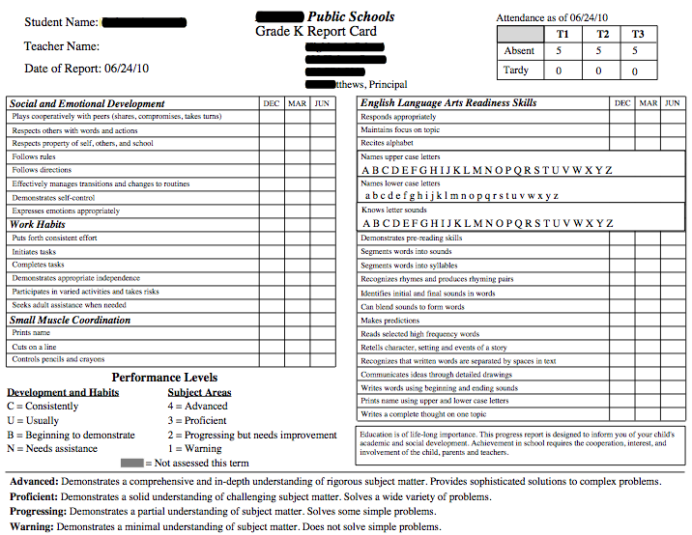

Location-Location-Location
The subliminal message do you send to your community by the placement of your subjects?
UPPER LEFT of page #1 is BOARDWALK

Slide 12
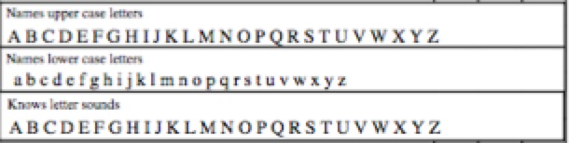
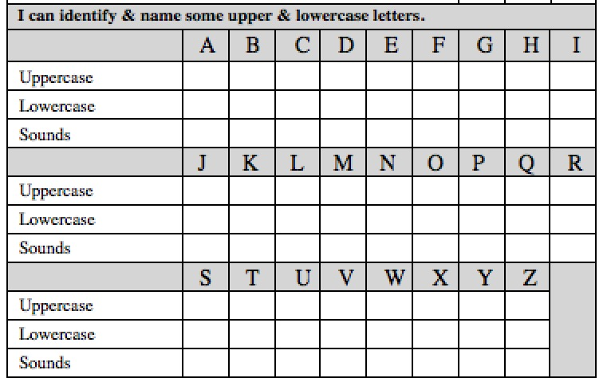
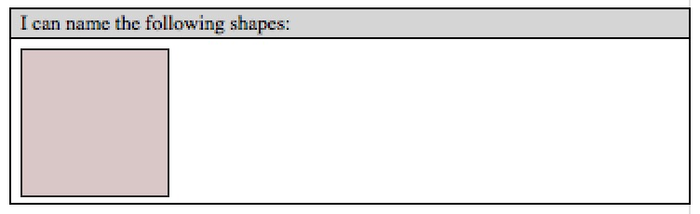

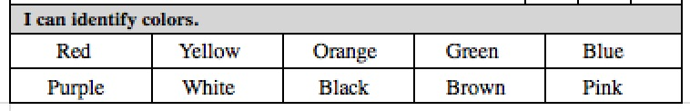
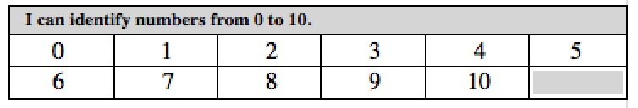
Constraints/Decisions
Letter Recognition and Sounds
Post Printing Circles – No Historical Record T2T
Post Printed √ – No Historical Record T2T
IF STANDARDS – 78 standards – Ask Teachers?
Shape/Color and Number Recognition
This picture is stored like school
logo’s. JPG
If you choose summative standards for concepts, you may need to provide parents with term
benchmark expectations!

Slide 13
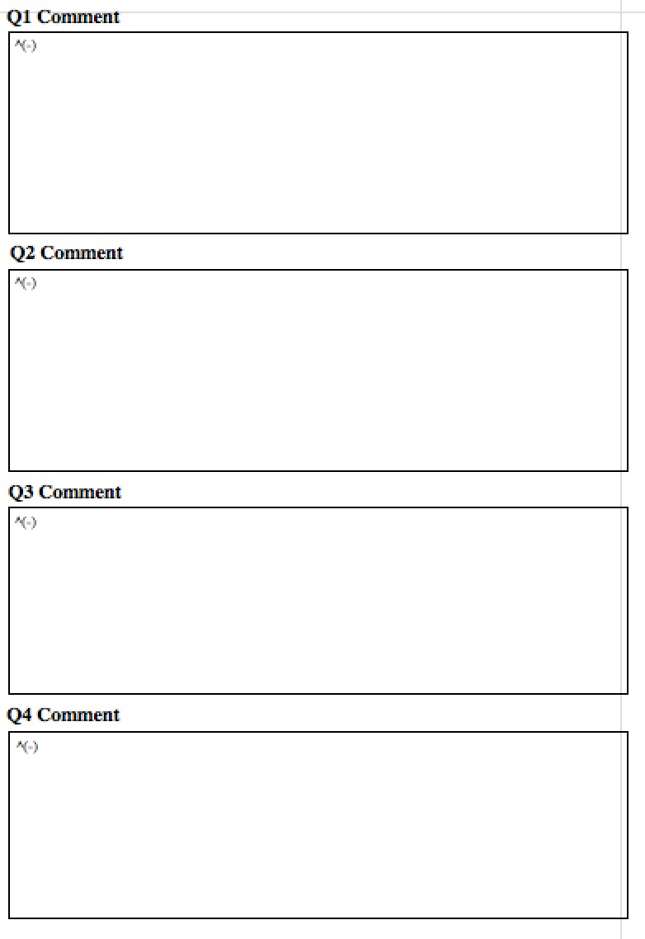
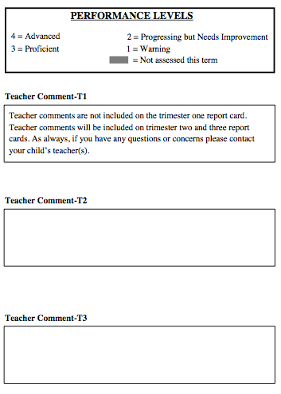
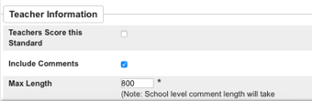

Summative - Student Records
All comments- 1 report card in Student Record Folder
Better Identifier??
^(*std.stored.comments;ELA.4.50;T1)
^(*std.stored.comments;MA.4.17;T1)
Stay inside the lines
Teachers will write TOO MUCH!
Set Max Width to keep text in the box
SOMEONE must inform teachers of character max count!
WHO GETS A COMMENT?

Slide 14
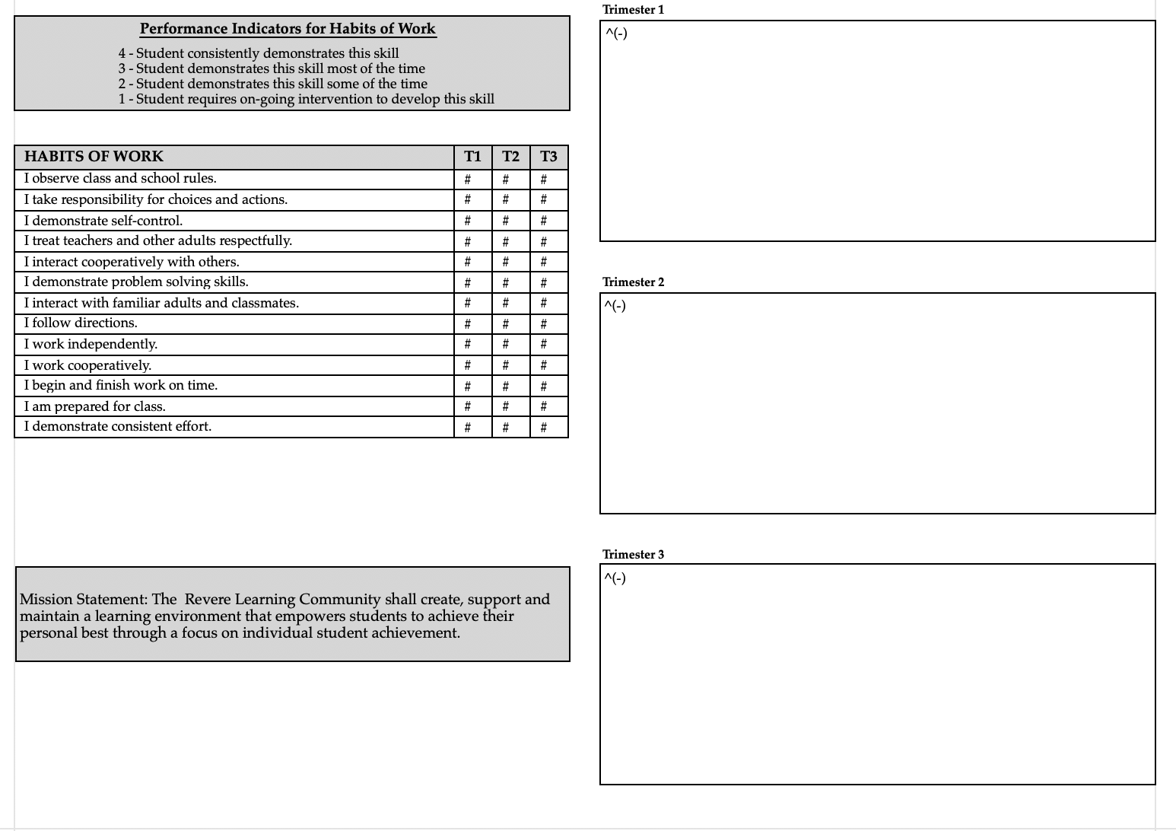
Comments – All subjects vs content specific
HR Teacher for all core academic subjects
Create a standard called Teacher Comment at the end
Of Habits of Work
Set Character Limit to fit within this box. Try to use the same sized box on each report card

Slide 15
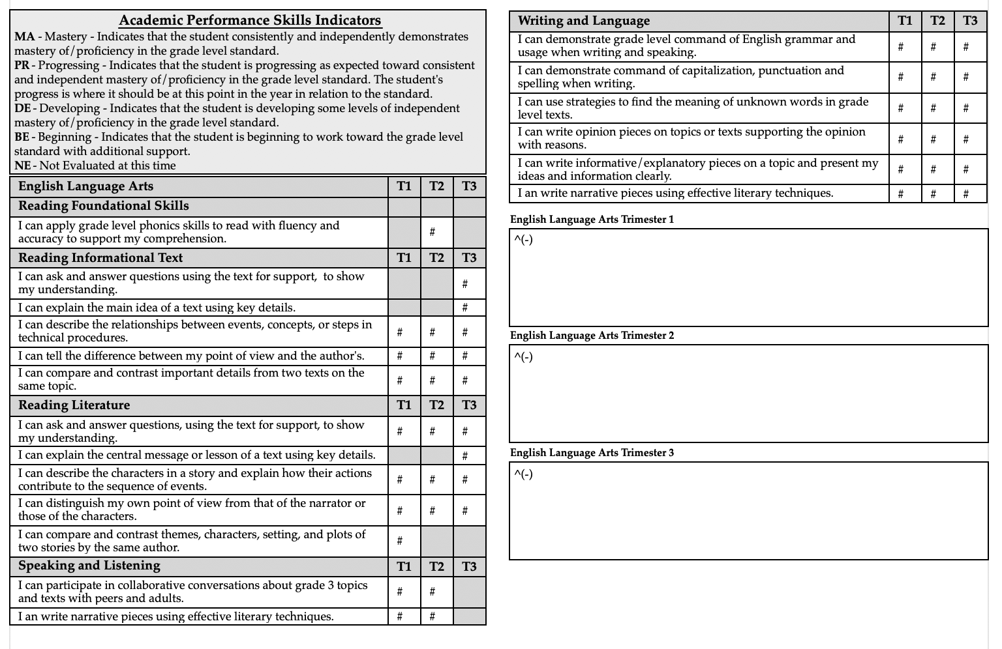
Different teachers for content specific courses
Options – ELA comments following ELA Standards
OR place all core content area comments on a single page.
ELA/MA more characters than SS/SCI

Slide 16
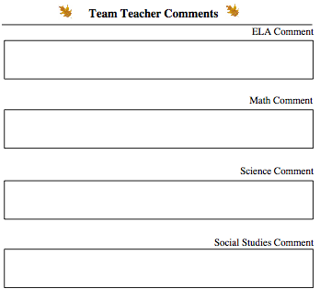


Content Specific Comments
Typically reserved for MS Level
Requires considerably more Real Estate
If space is not available, tech team must change code as needed
ALWAYS
SMALLER
^(*std.stored.comments;02.LA.50;Q4)
Who gets to enter a comment?
To stay within lines Max Width needs to be set for each comment area.
Object Reports – FIXED BOUNDARIES
Ask K-5 teachers if they want ONE COMMENT BOX
OR SUBJECT COMMENTS?
MOST WANT JUST 1

Slide 17
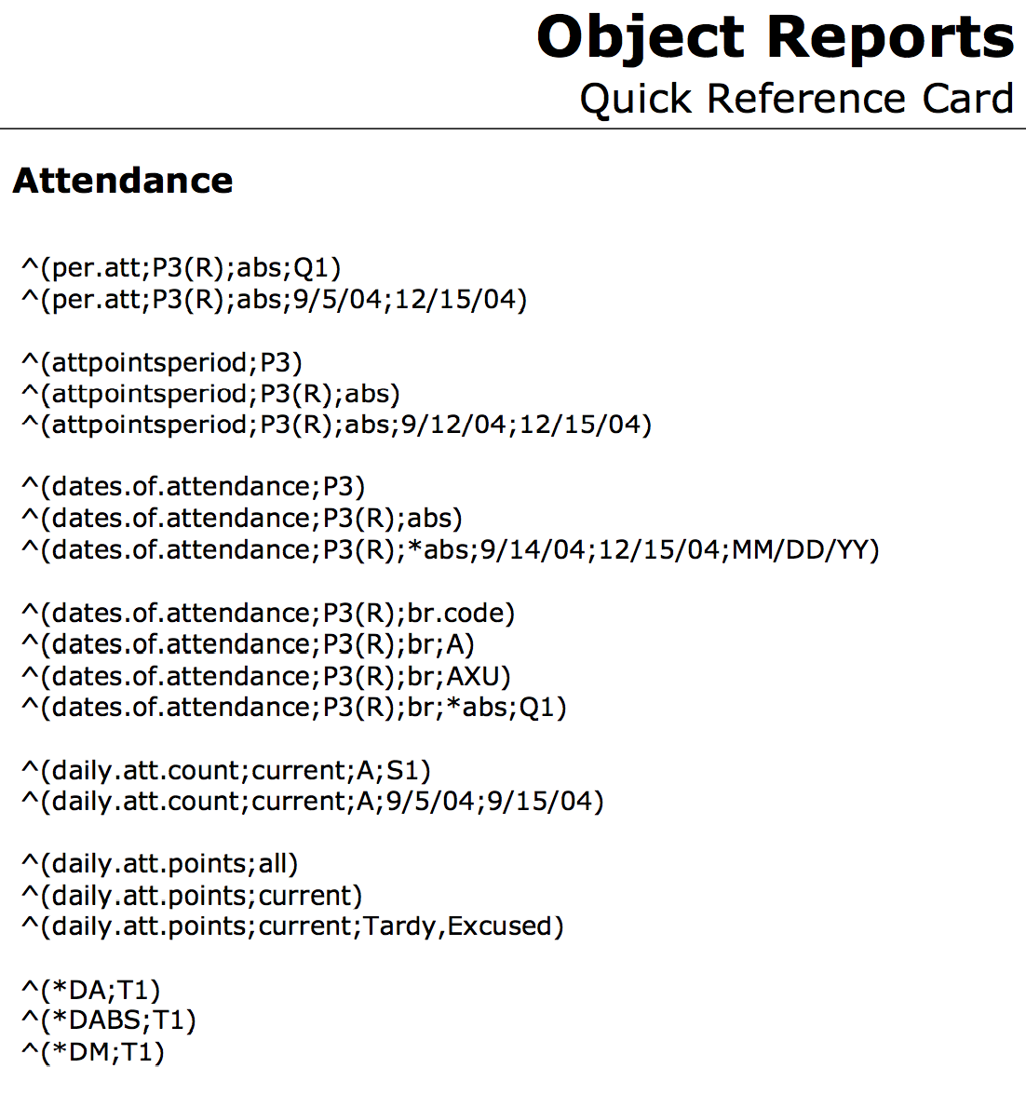

Attendance Codes & Chasing Ghosts
TEST EARLY & OFTEN - SEPTEMBER 15th
PRINT THEM TOO!!!

Slide 18
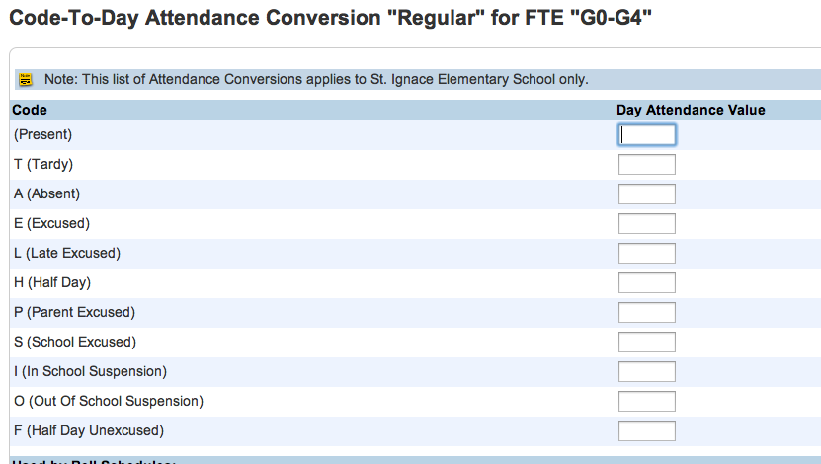
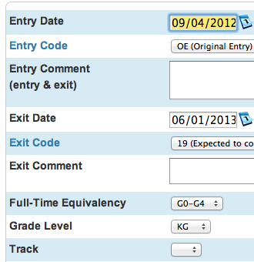
Chasing Attendance Ghosts
SPECIAL NOTE – IF THE CODE WORKED LAST YEAR BUT NOT THIS YEAR
Check Code to Day Conversion Values
“sometimes” the EOY process does copy these values from last year and you’ll find this page blank!
SPECIAL NOTE – IF THE CODE WORKS FOR MOST STUDENTS BUT NOT ALL
Check Transfer Info for FTEid Value
If Full-Time Equivalency can be BLANK especially if you IMPORT new students and forget to bring in that value

Slide 19
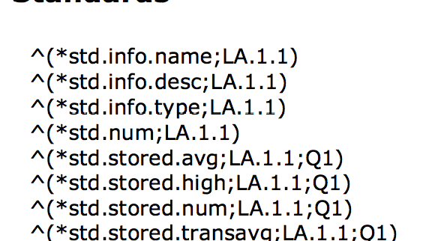
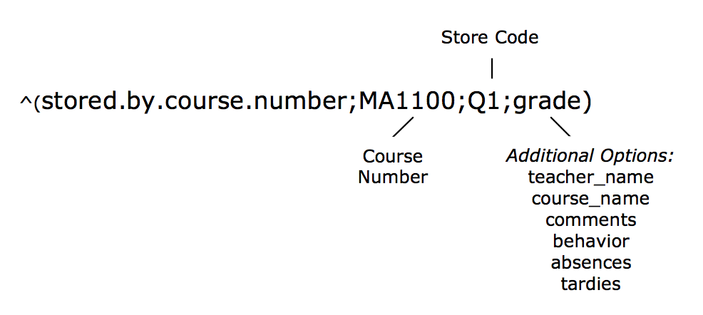
Which code to use/what will it display?
^(*std.stored.high;ELA.5.1;T1;2010) = highest stored grade for standard T1, 2010
^(*std.stored.num;ELA.5.1;T1;11) = average stored grade for standard T1 in Grade 11
^(*std.stored.transavg;ELA.5.1;T1) = stored number grade for standard T1
^(*std.transhigh;ELA.5.1) = stored number grade for standard
ParkBench Visual PST Version 3.1 makes standard grids W/O CODE!!!!
DO YOU HAVE THE POWERSCHOOL CODES?

Slide 20
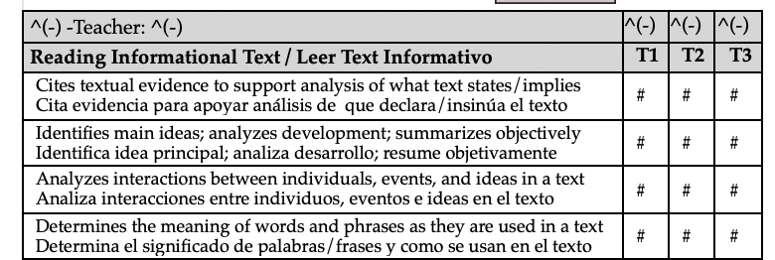
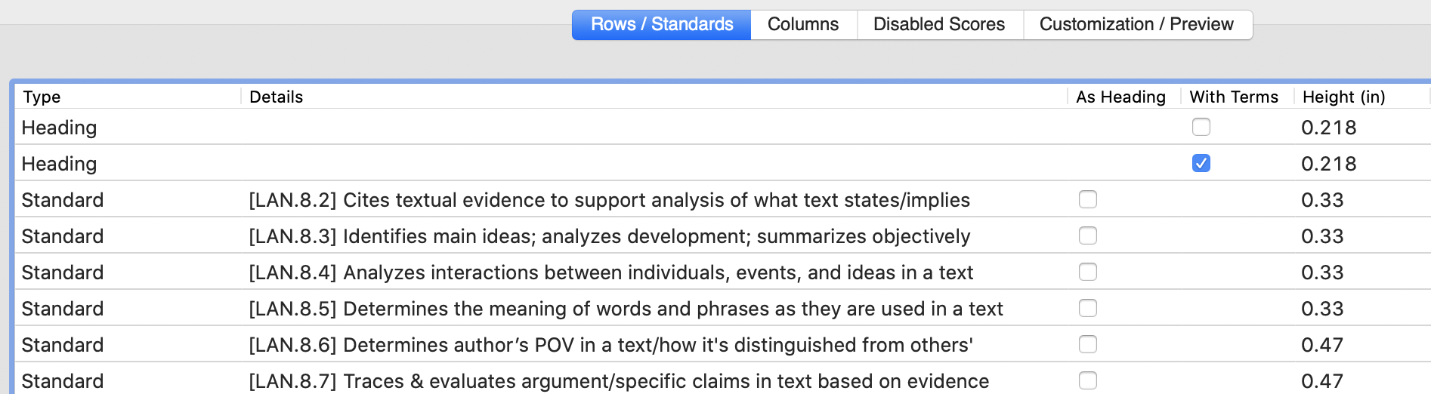
Hybrid Anyone?
^(stored.by.course.numberlist;8027,E0800XX,E0100XX,E0800PX,EO800RX;T1;course_name) -Teacher: ^(stored.by.course.numberlist;8027,E0800XX,E0100XX,E0800PX,EO800RX;T1;teacher_name)
^(stored.by.course.numberlist;8027,E0800XX,E0100XX,E0800PX,EO800RX;T1;grade)
^(stored.by.course.numberlist;8027,E0800XX,E0100XX,E0800PX,EO800RX;T2;grade)
^(stored.by.course.numberlist;8027,E0800XX,E0100XX,E0800PX,EO800RX;T3;grade)

Slide 21
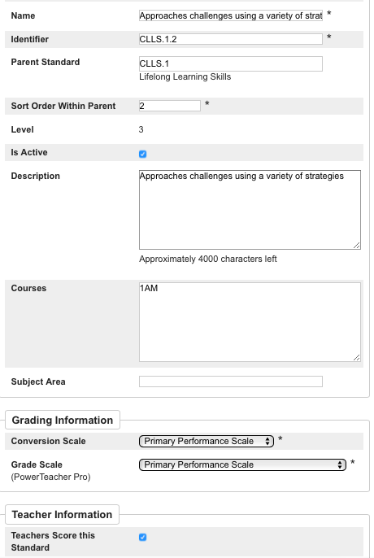
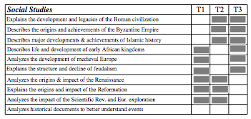
= Not Assessed This Term – Strategies!
Teachers will have to either:
1) leave standard blank
2) select a conversion scale choice of NA
3) All standards will be seen by teacher even if correct term is selected – no element refers to term ID UNLESS someone changes the Enable selection
Not Recommended as this
will be a repeatable labor cost

Slide 22
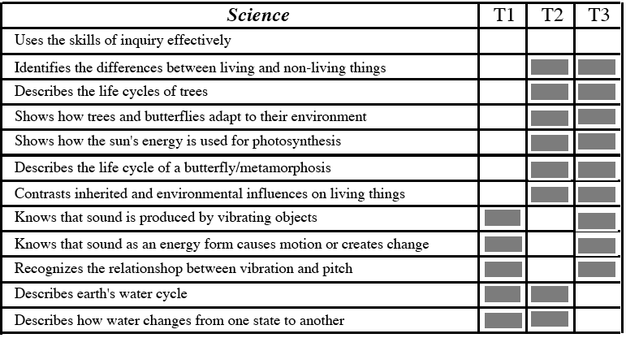

STANDARDS by TERM
ParkBench Visual PST V3.1 gives you the ability shade in gray!

Slide 23
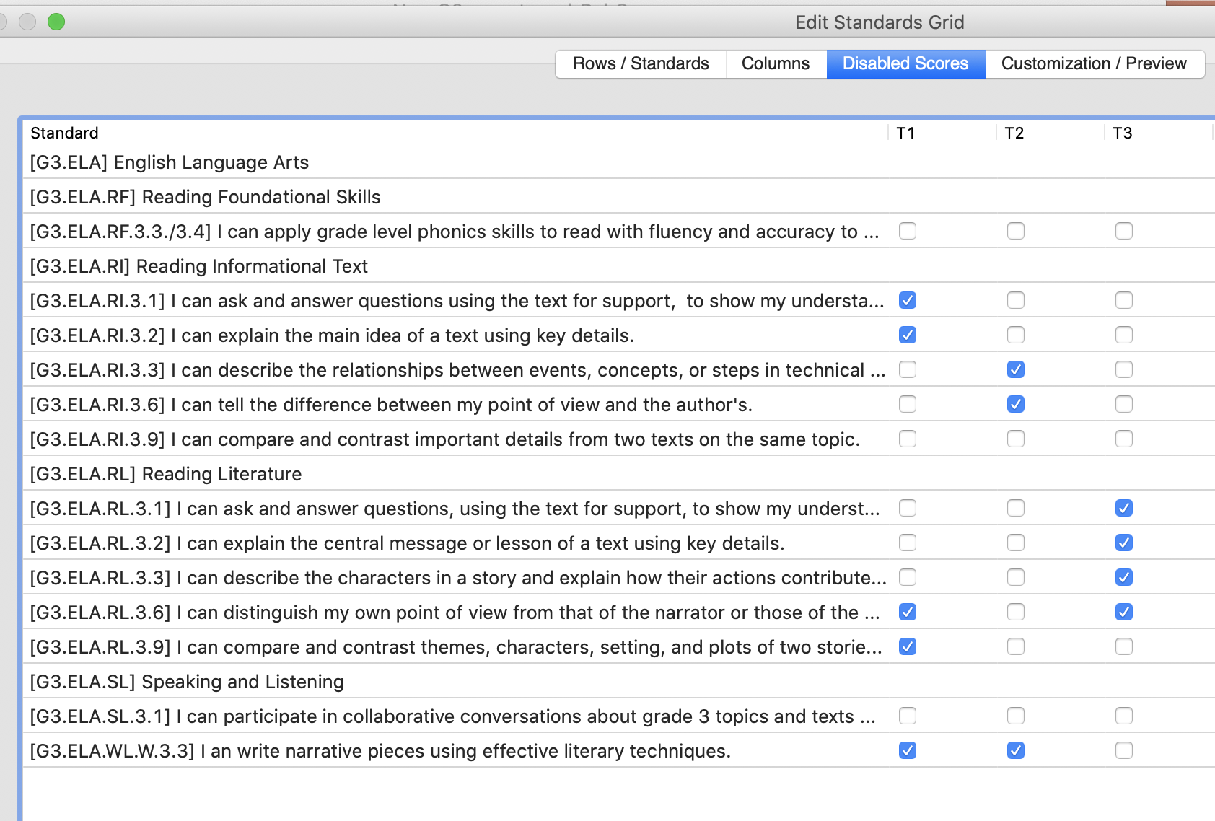
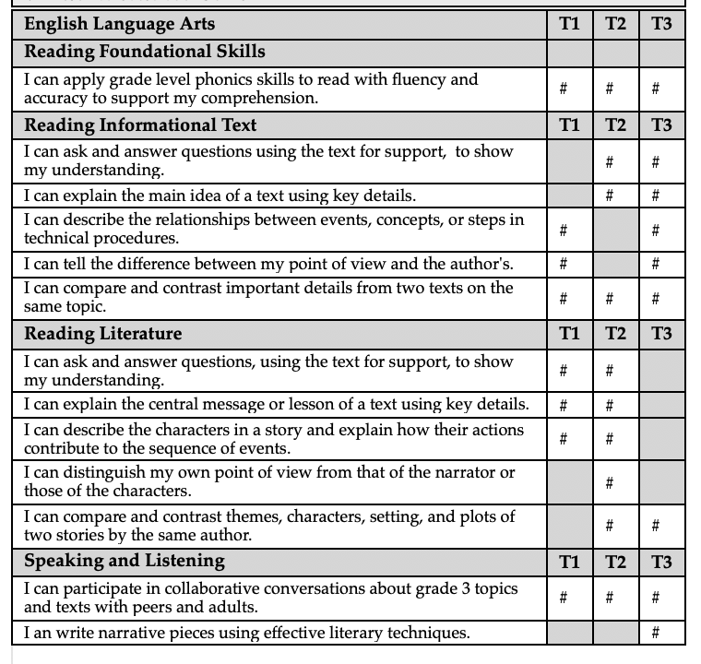
Gray Boxes – Disabled Scores
Version 3.1 check a box rather than draw a box!!

Slide 24


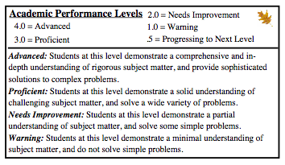
BE ON THE SAME PAGE Key/Assessments
Avoid confusion with homebound papers: Curriculum/Admin issue NOT Technical!
Sending Home Letter Grades and Percentages will confuse Parents and Students

Slide 25

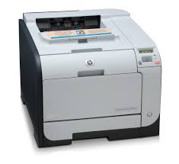
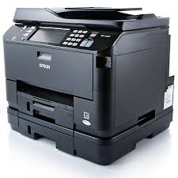
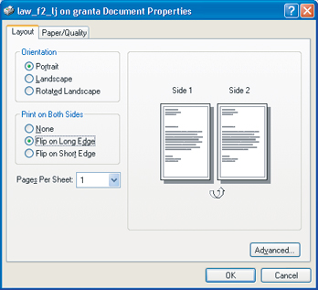
Multi-page Reports
Duplex Printers - Stapler
Name of student on each odd #’d page!
Check Margins – Edge to Edge is different
on each printer.
Different on Screen vs. Print Out
New Printers.. CHECK REPORTS

Slide 26
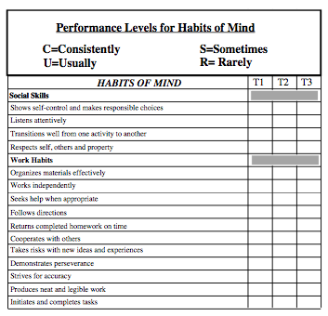

21st Century Effort
Habits of Mind
Essential Skills for Learning
Social Demeanor
Usually associated to a HR
District-based
80% same for all grades
Elementary – One teacher – all subjects
Middle School – Multiple teachers – individual subjects
Standard for each, spacing code is significant for the section below

Slide 27

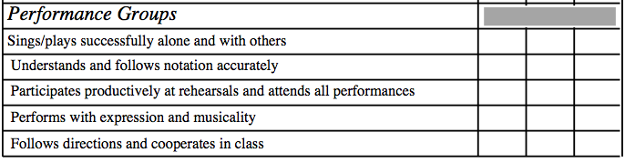
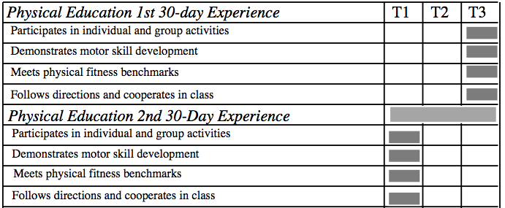

Not Dynamic – space for everything
Have admin consider limiting standards in each content area!
Battlegrounds between core academics and special subjects
Generic Standards for all Performance Groups (BCO) and Foreign Language (F,S,C,L)
G e t R e a d y t o R u m b l e
If Specials do not get comments,
Try to include an effort/behavior
standard!
Strategy:
Less standards if class doesn’t meet daily

Slide 28
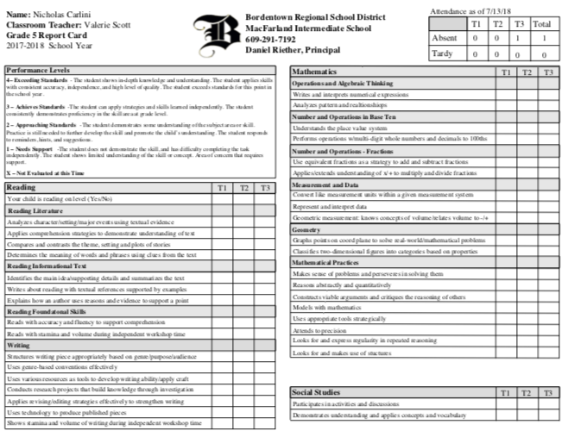
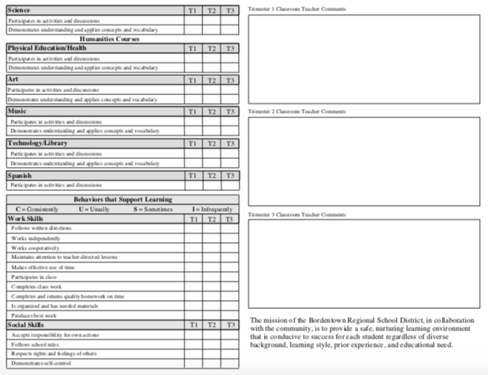
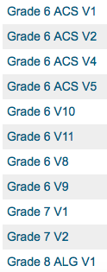
Time Saving Tip
BUILD FOR PERFECTION/SIGN-OFF
AM 1 GRADE LEVEL – upload it with different version #’s
DUPLICATE FILE and BEGIN your next Grade Level, section appear on each grade level
FEEDBACK for Curriculum team is essential

Slide 29
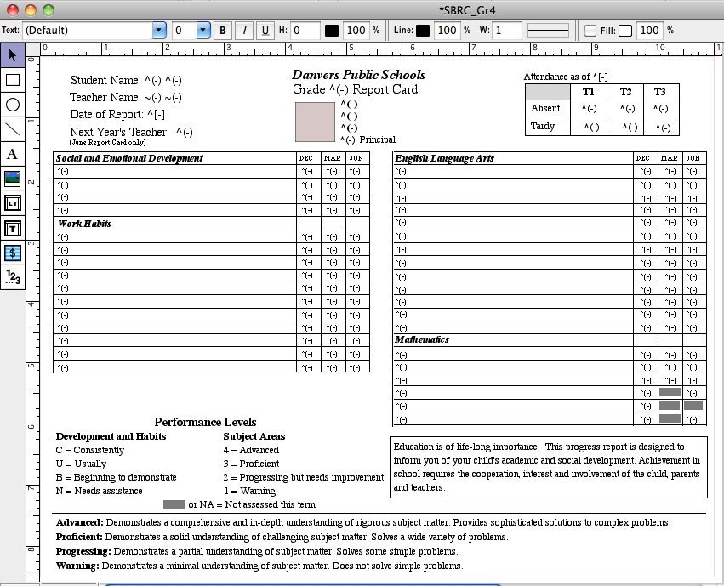

What you see is what you get object report writer
Design Sign-off
Build for perfections!
Need an example?
derotechnical.com/REPORTCARDS/SampleReportCards.html
Coding will have to be changed!

Slide 30
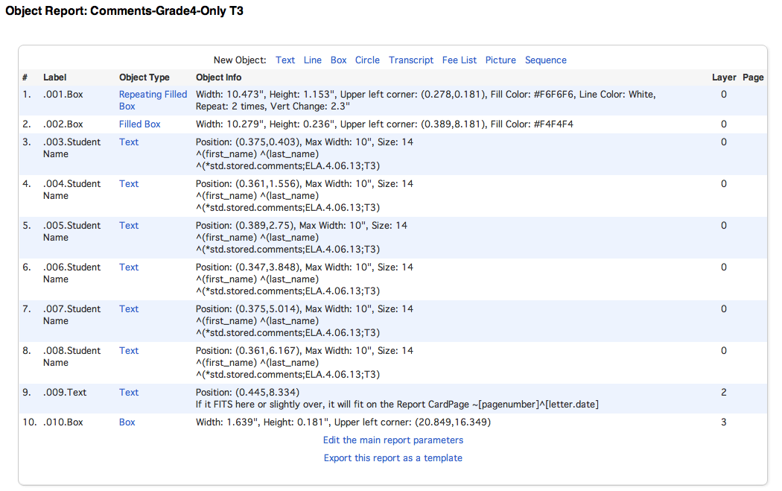
Corrections on screen or print?
Create a comment only report for teachers rather than printing entire report cards
Sample available on DERO Technical Website- Report Cards!

Slide 31

Report Tools for the Future?
Traditional – Handwritten
Traditional – Electronic
Standards
  Anchor Standards
  Common Core
  Rubric Assessments by Term
  Graphical Progress on Standards
Online/Web-based
Push Technology
Audio
Video
Cumulative K-12 with yearly progress on Graduation
Local/State and National Comparisons
NO Printed Report Cards – Parent Portal Only!
What is your Best Guess?

Slide 32

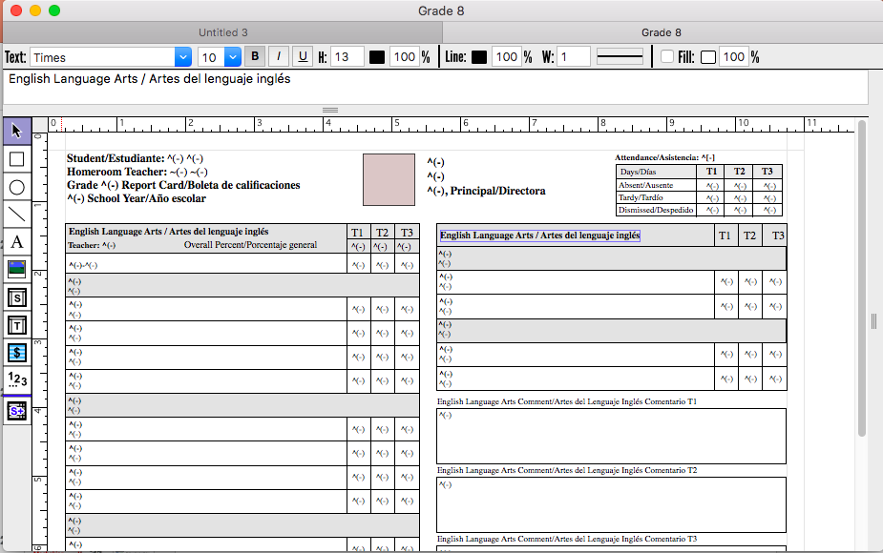


Report Card Options

Slide 33
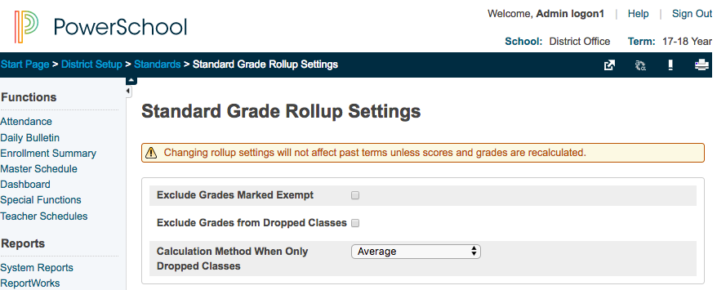
Standard Grades and DAT coded report cards
Most Object Reports use a DAT code ^(*std.stored.transavg;ELA.2.2;T1)
Did you know…
Standard grades are given to specific sessions of course. In the case above ELA for Grade 2
If a student transfers/drops a class, the new teacher has no way to check the standards the previous teacher gave to that student.
The math behind the scenes makes it difficult an accurate final grade to be calculated IF the previous teacher graded the standards or any sub standard if you are using auto-calculate parent standards,
Starting in Version PS 12.01 administrators must select either of these options BEFORE THE START OF THE SCHOOL YEAR.

Slide 34

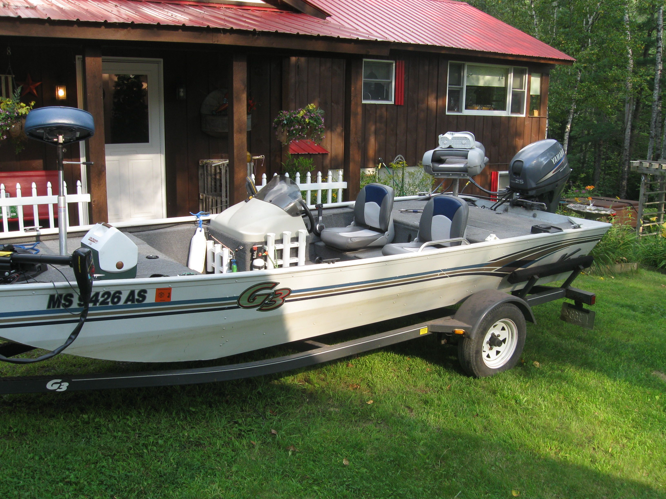

http://www.parkbenchsoftware.com/
Current District Pricing : $395 / year
Demo Licenses are available – send me an email!
get2bobc@gmail.com

Slide 35
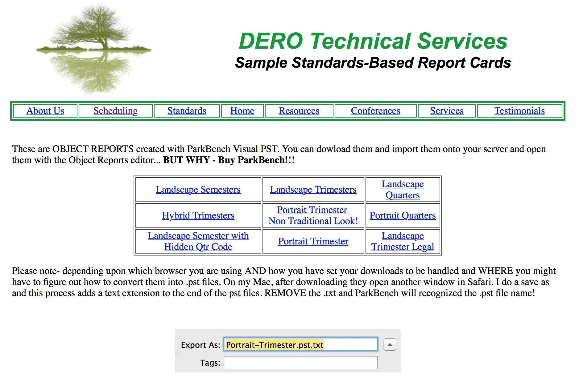

Slide 36


DELIMMA
Special Needs Students
Please √ with your Special Needs Department for State Regulations
HOW

Slide 37


Slide 38

Check out the Standard Grid Tool in ParkBench VisualPST Version 3
If you would like a day demo license
email get2bobc@gmail.com

Slide 39




Slide 40
ANY AND ALL DERO RESOURCES ARE AVAILABLE
TO DOWNLOAD, TWEAK and USE FOR YOUR DISTRICT!
Q & A
Bob Cornacchioli
get2bobc@gmail.com
www.derotechnical.com

